Slide 1
Class, Object & Method
By Aksadur Rahman
aksadur@yahoo.com

Slide 2
Agenda
Object Oriented Programing (OOP)
Classes
Objects
Introducing Method
Default Constructors Parameterized Constructor
Pass Statement
Intro to Inheritance Single Inheritance Hierarchical Inheritance Multilevel Inheritance Multiple Inheritance Method Overloading Method Overriding Encapsulation
Polymorphism

Slide 3
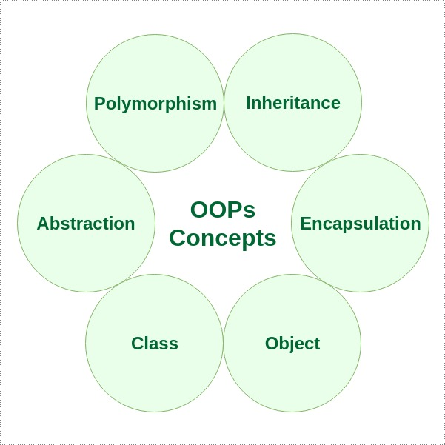
Object Oriented Programing (OOP)
Object-oriented programming (OOP) is a computer programming model that organizes software design around data, or objects, rather than functions and logic. An object can be defined as a data field that has unique attributes and behavior.

Slide 4
Classes
Classes are user-defined data types that act as the blueprint for individual objects, attributes and methods
An example of a class is the class Student. Students usually have a roll and gpa; these are attributes.
class student :
roll= ""
gpa = ""

Slide 5
Objects
An Object is an instance of a Class. A class is like a blueprint while an instance is a copy of the class with actual values.
kamal = student()
kamal.roll = 10
kamal.gpa = 3.75
print(f"Roll ={kamal.roll}, GPA={kamal.gpa}")

Slide 6
Introducing Method
A method is a function that “belongs to” an object.
class student:
def set_value(self, roll, gpa):
self.roll=roll
self.gpa=gpa
def display(self):
print(f"Roll ={self.roll}, GPA={self.gpa}")
kamal = student()
kamal.set_value(10, 3.75)
kamal.display()

Slide 7
Default Constructors
Constructors are generally used for instantiating an object
class student:
def __init__(self):
self.section="A"
def display(self):
print(f"section = {self.section}")
kamal = student()
kamal.display()

Slide 8
Parameterized Constructors
Constructors are generally used for instantiating an object
class student:
def __init__(self, roll, gpa):
self.roll=roll
self.gpa=gpa
def display(self):
print(f"Roll ={self.roll}, GPA={self.gpa}")
kamal = student(10, 3.75)
kamal.display()

Slide 9
Pass Statement
Create a placeholder for future code:
class Person:
pass
def myfunction():
pass

Slide 10
Intro to Inheritance
Inheritance allows us to define a class that inherits all the methods and properties from another class.
Parent class is the class being inherited from, also called base class.
Child class is the class that inherits from another class, also called derived class.
Parent class
Child class
class Person:
def __init__(self, fname, lname):
self.firstname = fname
self.lastname = lname
def printname(self):
print(self.firstname, self.lastname)
#-----------------------------------------------------
x = Person("John", "Doe")
x.printname()
class Student(Person):
pass
#----------------------------------
y = Student("Abul", "Hossain")
y.printname()

Slide 11
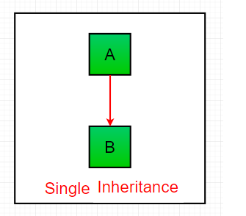
Single Inheritance
class A:
def display1(self):
print("This is class A")
class B(A):
def display2(self):
print("This is class B")
objB = B()
objB.display1()
objB.display2()

Slide 12
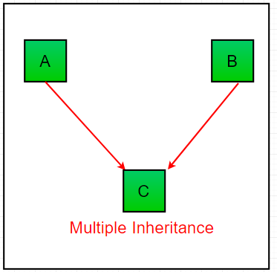
Multiple Inheritance
class A:
def display1(self):
print("This is class A")
class B:
def display2(self):
print("This is class B")
class C(A, B):
def display3(self):
print("This is class C")
objC = C()
objC.display1()
objC.display2()
objC.display3()

Slide 13
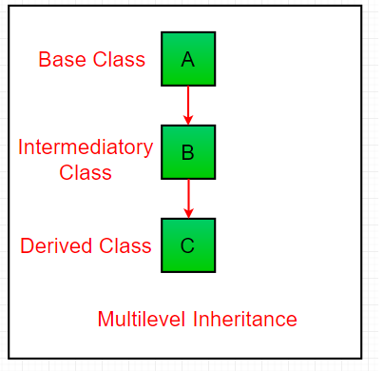
Multilevel Inheritance
class A:
def display1(self):
print("This is class A")
class B(A):
def display2(self):
print("This is class B")
class C(B):
def display3(self):
print("This is class C")
objC = C()
objC.display1()
objC.display2()
objC.display3()

Slide 14
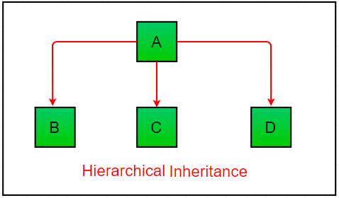
Hierarchical Inheritance
class Parent: # Base class
def func1(self):
print("This function is in parent class.")
class Child1(Parent): # Derived class1
def func2(self):
print("This function is in child 1.")
class Child2(Parent): # Derivied class2
def func3(self):
print("This function is in child 2.")
# Driver's code
object1 = Child1()
object2 = Child2()
object1.func1()
object1.func2()
object2.func1()
object2.func3()

Slide 15
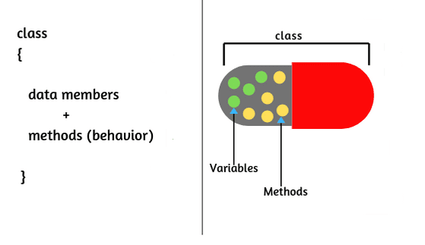
Encapsulation
Encapsulation in Python describes the concept of bundling data and methods within a single unit. So, for example, when you create a class, it means you are implementing encapsulation.

Slide 16
Polymorphism
Polymorphism is taken from the Greek words Poly (many) and morphism (forms). It means that the same function name can be used for different types.
#Built in Polymorphic function
print(len("Aksadur Rahman"))
print(len([10, 20, 30]))
#User define polymorphic function
def add(x, y, z=0):
return x+y+z
print(add(30, 20))
print(add(10, 30, 20))

